Slide 1



Noida Institute of Engineering and Technology, Greater Noida
Security Policy
Unit: 5
Cyber Security
ANC0301
Sujeet Singh Bhadouria
Assistant Professor
(CSE)
NIET, Gr. Noida
(B Tech IIIrd Sem)

Slide 2
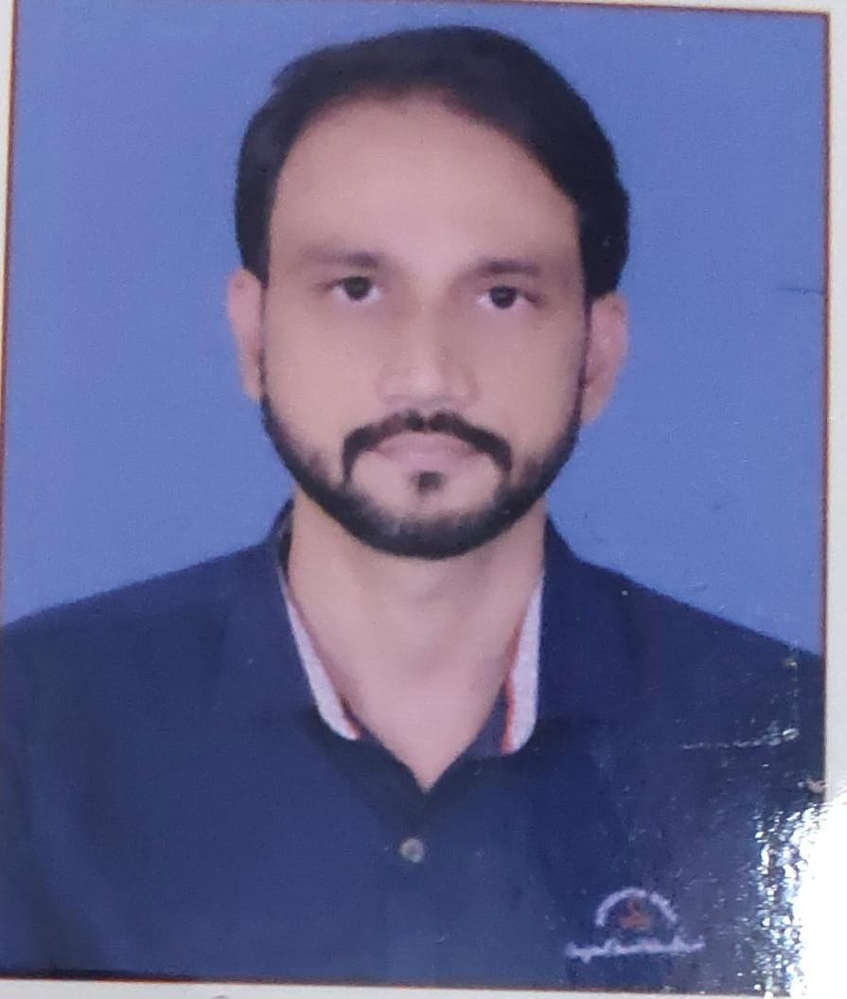
Faculty Profile
FACULTY PROFILE
Name of Faculty: Sujeet Singh Bhadouria
Designation & Department: Assistant Professor, CSE
Qualification: Ph.D (Pre-Submission) M.Tech
Experience: 10 Years of teaching experience
Area of Interest: Computer Network
Reviewer: IET Communications ISSN 1751-8644 (SCI & SCOPUS INDEX)
Research Publications:
International Journal 09
Paper Presentation 06
International Patent 01 (Granted)
National Patent 04

Slide 3
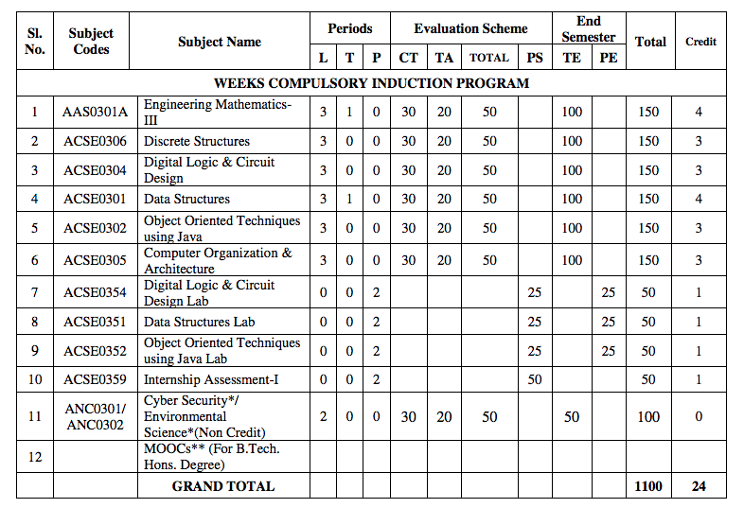
Evaluation Scheme

Slide 4
Syllabus
Introduction:
Introduction to Information Systems: Types of Information Systems, Development of Information Systems, Need for Information Security, Threats to Information Systems, Information Assurance, Guidelines for Secure Password and WI-FI Security and social media and Windows Security, Security Risk Analysis and Risk Management.
Application Layer Security:
Data Security Considerations-Backups, Archival Storage and Disposal of Data, Security Technology-Firewall, Intrusion Detection, Access Control, Security Threats -Viruses, Worms, Trojan Horse, Bombs, Trapdoors, Spoofs, E-mail Viruses, Macro Viruses, Malicious Software, Network and Denial of Services Attack, Security, Threats to E-Commerce: Electronic Payment System, e- Cash, Issues with Credit/Debit Cards.

Slide 5
Syllabus
Secure System Development:
Application Development Security, Architecture & Design, Security Issues in Hardware: Data Storage and Downloadable Devices, Mobile Protection, Security Threats involving in social media, Physical Security of IT Assets, Access Control, CCTV and Intrusion Detection Systems, Backup Security Measures.
Cryptography and Network Security:
Public key cryptography: RSA Public Key Crypto with implementation in Python, Digital Signature Hash Functions, Public Key Distribution.
Symmetric key cryptography: DES (Data Encryption Standard), AES (Advanced Encryption Standard), Secure hash algorithm (SHA-1).
Real World Protocols: Basic Terminologies, VPN, Email Security Certificates, Transport Layer Security, TLS, IP security, DNS Security.

Slide 6
Syllabus
Security Policy:
Policy design Task, WWW Policies, Email based Policies, Policy Revaluation Process-Corporate Policies-Sample Security Policies, Publishing and Notification Requirement of the updated and new Policies.
Recent trends in security.

Slide 7
Applications
There are many cyber security real-life examples where financial organizations like banks and social organizations, weather channels etc. have faced cyber-attacks and have lost valuable information and resources. To fix these problems, you'll need comprehensive cyber security awareness.
According to KPMG, the annual compensation for cyber security heads ranges from 2 Cr to 4 Cr annually. The industry also reports a satisfaction level of 68%, making it a mentally and financially satisfying career for most.

Slide 8
Course Objective
Students will learn about :
Security of Information system and Risk factors.
Examine security threats and vulnerability in various scenarios.
Understand concept of cryptography and encryption technique to protect the data from cyber-attack
Provide protection for software and hardware.

Slide 9
Course Outcome
After successful completion of this course student will be able to -
COURSE OUTCOME NO. | COURSE OUTCOMES | Bloom’s Knowledge Level (KL)
CO1 | Analyze the cyber security needs of an organization. | K4
CO2 | Identify and examine software vulnerabilities and security solutions. | K1, K3
CO3 | Comprehend IT Assets security (hardware and Software) and performance indicators. | K2
CO4 | Measure the performance and encoding strategies of security systems. | K3, K5
CO5 | Understand and apply cyber security methods and policies to enhance current scenario security. | K2, K3

Slide 10
Program Outcomes
Engineering knowledge
Problem analysis
Design/development of solutions
Conduct investigations of complex problems
5. Modern tool usage
The engineer and society
Environment and sustainability
11/15/2022
Notes:
10

Slide 11
Program Outcomes…(cont.)
8. Ethics
Individual and team work
10. Communication
Project management and finance
Life-long learning
11/15/2022
11
Notes:
11

Slide 12
CO-PO Mapping
CO-PO Mapping
PO No. CO No. | PO1 | PO2 | PO3 | PO4 | PO5 | PO6 | PO7 | PO8 | PO9 | PO10 | PO11 | PO12
CO1 | 2 | 2 | 1 | 2 | - | - | - | 1 | 2 | 1 | 2 | 2
CO2 | 2 | 2 | 2 | 2 | 2 | 1 | - | 1 | 2 | 1 | 2 | 2
CO3 | 2 | 2 | 1 | 2 | 2 | - | - | 1 | 2 | 1 | 2 | 2
CO4 | 2 | 2 | 1 | 2 | 2 | 1 | - | 1 | 2 | 1 | 2 | 2
CO5 | 2 | 2 | 1 | 2 | 2 | - | - | 1 | 2 | 1 | 2 | 2
*3= High *2= Medium *1=Low

Slide 13
Program Specific Outcomes
Program Specific Outcomes (PSOs) are what the students should be able to do at the time of graduation. The PSOs are program specific. PSOs are written by the department offering the program.
On successful completion of B. Tech. (CSE) Program, the Information and Technology engineering graduates will be able to:
PSO1 : Work as a software developer, database administrator, tester or networking engineer for providing solutions to the real world and industrial problems.
PSO2 : Apply core subjects of information technology related to data structure and algorithm, software engineering, web technology, operating system, database and networking to solve complex IT problems
PSO3 : Practice multi-disciplinary and modern computing techniques by lifelong learning to establish innovative career
PSO4 : Work in a team or individual to manage projects with ethical concern to be a successful employee
or employer in IT industry.
11/15/2022
13
Notes:
13

Slide 14
PSO Mapping
Program Specific Outcomes and Course Outcomes Mapping
CO | PSO1 | PSO2 | PSO3 | PSO4
CO1 | 2 | 2 | - | 2
CO2 | 2 | 2 | 1 | 2
CO3 | 2 | 2 | - | 2
CO4 | 2 | 2 | - | 2
CO5 | 2 | 2 | - | 2
*3= High *2= Medium *1=Low

Slide 15
Program Educational Objectives
The Program Educational Objectives (PEOs) of an engineering degree program are the statements that describe the expected achievements of graduates in their career, and what the graduates are expected to perform and achieve during the first few years after graduation.
PEO1: To have an excellent scientific and engineering breadth so as to comprehend, analyze, design and solve real-life problems using state-of-the-art technology.
PEO2: To lead a successful career in industries or to pursue higher studies or to understand entrepreneurial endeavors.
PEO3: To effectively bridge the gap between industry and academics through effective communication skill, professional attitude and a desire to learn.
11/15/2022
15
Notes:
15

Slide 16
Result Analysis
Faculty Name | Subject Name | Code | Result
Ms Ruchika Sharma | Cyber Security | ANC0301 | 100%

Slide 17
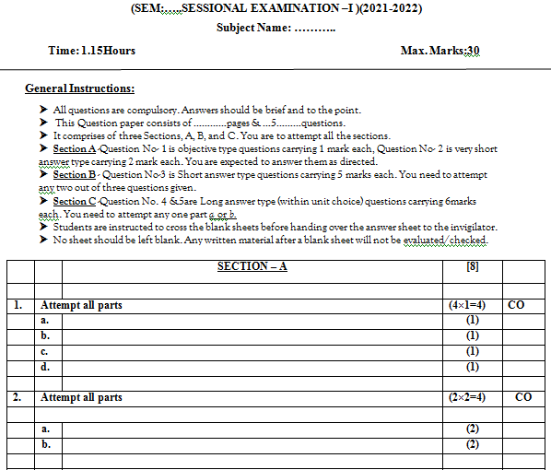
Question Paper Template

Slide 18
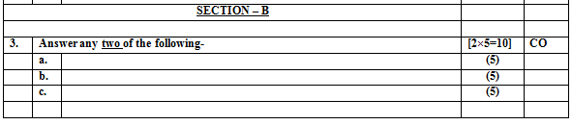
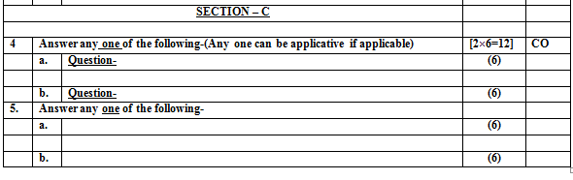
Question Paper Template

Slide 19
Question Paper Template
 |  | SECTION – A |  | CO
1. | Attempt all parts- |  | [10×1=10]
 | 1-a. | Question- | -1
 | 1-b. | Question- | -1
 | 1-c. | Question- | -1
 | 1-d. | Question- | -1
 | 1-e. | Question- | -1
 | 1-f. | Question- | -1
 | 1-g. | Question- | -1
 | 1-h. | Question- | -1
 | 1-i. | Question- | -1
 | 1-j. | Question- | -1
2 | Attempt all parts- |  | [5×2=10] | CO
 | 2-a. | Question- | -2
 | 2-b. | Question- | -2
 | 2-c. | Question- | -2
 | 2-d. | Question- | -2
 | 2-e. | Question- | -2

Slide 20
Question Paper Template
SECTION – B |  |  |  | CO
3 | Answer any five of the following- |  | [5×6=30]
 | 3-a. | Question- | -6
 | 3-b. | Question- | -6
 | 3-c. | Question- | -6
 | 3-d. | Question- | -6
 | 3-e. | Question- | -6
 | 3-f. | Question- | -6
 | 3-g. | Question- | -6

Slide 21
Question Paper Template
SECTION – C ​ |  |  | ​ | CO​
​ |  |  | ​ | ​
4​ | Answer any one of the following-​ |  | [5×10=50]​ | ​
​ | 4-a.​ | Question- ​ | -10​ | ​
​ | ​ | ​ | ​ | ​
​ | 4-b.​ | Question- ​ | -10​ | ​
5​ | Answer any one of the following-​ |  | ​ | ​
​ | 5-a.​ | Question- ​ | -10​ | ​
​ | ​ | ​ | ​ | ​
​ | 5-b.​ | Question- ​ | -10​ | ​
6​ | Answer any one of the following-​ |  | ​ | ​
​ | 6-a.​ | Question- ​ | -10​ | ​
​ | ​ | ​ | ​ | ​
​ | 6-b.​ | Question- ​ | -10​ | ​
7​ | Answer any one of the following-​ |  | ​ | ​
​ | 7-a.​ | Question- ​ | -10​ | ​
​ | ​ | ​ | ​ | ​
​ | 7-b.​ | Question- ​ | -10​ | ​
​ | ​ | ​ | ​ | ​
8​ | Answer any one of the following-​ |  | ​ | ​
​ | 8-a.​ | Question- ​ | -10​ | ​
​ | ​ | ​ | ​ | ​
​ | 8-b.​ | Question- ​ | -10​ | ​

Slide 22
Prerequisite/Recap
Basics recognition in the domain of Computer Science.
Concept of network and operating system.
Commands of programming language.

Slide 23
Introduction
Modern life depends on online services, so having a better understanding of cyber security threats is vital.
The course will improve your online safety in the context of the wider world, introducing concepts like malware, trojan virus, network security, cryptography, identity theft, and risk management.
https://www.javatpoint.com/cyber-security-introduction
https://www.edureka.co/blog/what-is-cybersecurity/
http://natoassociation.ca/a-short-introduction-to-cyber-security/

Slide 24
Content (Unit-5)
Policy design Task
WWW Policies
Email based Policies
Policy Revaluation Process-Corporate Policies-Sample Security Policies
Publishing and Notification Requirement of the updated and new Policies
Recent trends in security.

Slide 25
Unit Objective/Outcome
Topic | Objective
Policy design Task, WWW Policies, Email based Policies | Develop and examine an understanding of Secure Policies for WWW Policies, Email Security
Policy Revaluation Process-Corporate Policies-Sample Security Policies | Study of Policy Review Process for Corporate and Sample Security Policies for organization
Publishing and Notification Requirement of the updated and new Policies | Study of Publishing and Notification Requirement
Recent trends in security | Examine security of mobile devices , cloud, Outsourcing, and supply chain management

Slide 26
Topic Mapping with CO
Topic | CO
Policy design Task, WWW Policies, Email based Policies | CO5
Policy Revaluation Process-Corporate Policies-Sample Security Policies | CO5
Publishing and Notification Requirement of the updated and new Policies | CO5
Recent trends in security | CO5

Slide 27
Recap
In the previous unit we learnt about Public key cryptography and Symmetric key cryptography.
Also gained knowledge about various Real World Protocols and Basic Terminologies like VPN, Email Security Certificates, Transport Layer Security, TLS, IP security, DNS Security.

Slide 28
Policy Design Task (CO5)
An information security policy should be part of any organization’s overall asset security policy.
The security policies, standards, and procedures define a security program.
The information security professionals of an organization are responsible to implement security policies that depict the business and mission requirements of an organization.

Slide 29

Development of Policy (CO5)
Define Goal of the Policy
Define What Policies Need to Be Written
Perform a Risk Assessment/ Analysis or Audit
Review
Approval, and Enforcement

Slide 30
Development of Policy
Step-1: Define Goal of the Policy (What and Why)
Before policy documents can be written, the overall goal of the policies must be determined.
Example- Is the goal to protect the company and its interactions with its customers? Or will you protect the flow of data for the system?
In any case, the first step is to determine what is being protected and why it is being protected.

Slide 31
Development of Policy
Step 2 : Define What Policies Need to Be Written
Rather than trying to write one policy document, write individual documents and call them chapters of your information security policy.
By doing so, they are easier to understand, easier to distribute, and easier to provide individual training with because each policy will have its own section.
Smaller sections are also easier to modify and update.
How many policies should you write?

Slide 32
Development of Policy
Step-3 Perform a Risk Assessment/Analysis or Audit
The only way to understand your infrastructure is to perform a full risk assessment, risk analysis, or audit on the entire enterprise.
By doing so, policy writers can obtain a great understanding on the reach of information technology within the organization.
Step-4: Review
The review process should consider not only the technical aspects of security, but also the legal aspects of it as it relates to the organization.
Prior to authoring any policies, there should be a clear understanding of the overall review process.

Slide 33
Development of Policy
Step- 5 : Approval, and Enforcement
The approval process is a simple matter of the management agreeing to the final version of the document. Their approval should come after it is reviewed.
Finally, after the policy is written, approved, and administrators implement its directive, the policy must be enforced. Policies that are not enforced will be broken at will. It is the same as laws that are not enforced in society.

Slide 34
When Policies Should be Developed?
Ideally, the best time to define your policies should be before your first security problem.
Also it is always easier to write policy for a developing infrastructure rather than trying to retrofit it into an existing business environment.
After a Security Breach
Demonstrate Quality Control Processes
Document Compliance with Government

Slide 35
Need for Policy Development
Identify What Is to Be Protected
Identify From Whom It Is Being Protected
Data Security Considerations
Backups, Archival Storage, and Disposal of Data
Intellectual Property Rights and Policies

Slide 36
Security Policies
Organizations are required to develop and maintain specific security policies and procedures. Apart from designing a security policy, its review process is also essential to ensure that the policy is appropriate or adequate.
Some Examples are-
The World Wide Web (WWW) policy
The e-mail security policy
The corporate policy
Sample security policy

Slide 37
WWW Policy(CO5)
Introduction to Web Security
Internet has facilitated most of our operations and services through web sites
Majority of the on-line users spend their time in referring to the web sites for their everyday work
These are vulnerable to cyber-attacks
Cyber-attacks can be executed on web sites, web servers and web applications.

Slide 38
WWW Policy
Why Web Security?
The purpose of web-security is to prevent the web sites, web servers and web applications from cyber-attacks
It is defined as the act or practice of protecting websites from
Unauthorized access
Use
Modification
Destruction or
Disruption
It plays major role in preventing users against vulnerabilities

Slide 39
WWW Policy
Website Security issues
Caused due to improper development
of source code
• More possibilities of bugs and security
loopholes
Website source code
Highly vulnerable to attacks
Difficult to distinguish genuine user from illegitimate user at times of large number of visitors
Website visitor access
• Many new methods are found by hackers
and implemented
• Web security software and malware does not
differentiate are methods used to handle the
issues
Sophistication of Website security attacks
Source: Swayam

Slide 40
Web Security Risks(CO5)
SQL Injection
Password Breach
Data Breach
Remote File Inclusion
Code Injection
Cross Site Scripting (XSS)
Broken Authentication and Session Management
Insecure Direct Object References
Cross Site Request Forgery(CSRF)
Security Misconfigurations
Insecure Cryptographic Storage
Failure to Restrict URL Access
Insufficient Transport Layer Protection
Un-validated Redirects and Page Forwards

Slide 41
WWW policy to Avoid Risks
No offensive or harassing material may be made available through company websites.
No personal commercial advertising should be made available through company websites.
The personal material on or accessible from the website should be minimal.
No company confidential material should be made available
Users of an organization should not be permitted to install or run Web servers

Slide 42
E-mail System(CO5)
E-mail is the popular form of sending or exchanging information between two or many parties
Despite being popular, malware, spam and phishing attacks are executed
E-mail also acts the entry point for the enterprise network to gain access to their valuable data

Slide 43
E-mail Security
It deals with the different techniques to secure the information sent through email
The e-mail accounts are prevented from unauthorized access, loss, or compromise
It is important to provide e-mail security as individuals and business organizations expand their extensive communication through email

Slide 44
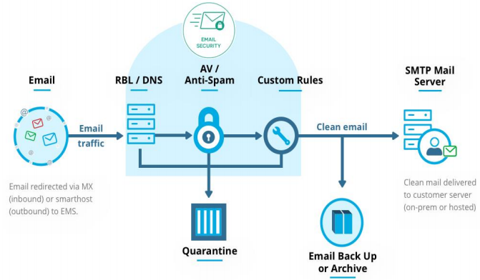
E-mail Security
Source: Swayam

Slide 45
Need for E-mail Security
Every organisation must employ e-mail administrators responsible in providing security to the e-mail system
It is important to provide e-mail security as individuals and business organizations expand their extensive communications through e-mail
Hence E-mail messages must be secured as they are delivered and received across un-trusted networks

Slide 46
Importance of E-mail Security
It provides security over external networks security i.e., outside the organization’s boundary
It maintains the CIA of information transferred through e-mail
It provides implementation of good management system planning by continuous monitoring
It also maintains the effectiveness of the e-mail system and IT infrastructure

Slide 47
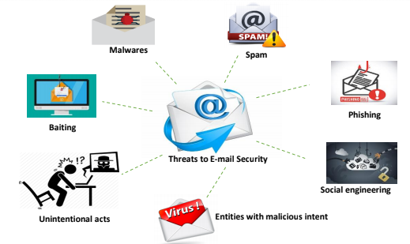
Common Threats to e-mail security
Source: swayam

Slide 48
E-mail Security Policy(CO5)
An organization can include the following “Ten Commandments of E-mail” while developing an e-mail policy:
You will [may be replaced may be complicated by readers] demonstrate the same respect that gives to verbal communications.
You will check the spelling, the grammar, and read own message thrice before you send it.
You will not forward any chain letter.

Slide 49
E-mail Security Policy
You will not transmit unsolicited mass e-mail (spam) to anyone.
You will not send messages that are hateful, harassing, or threatening unto fellow users.
You will not send any message that supports illegal or unethical activities.
You will remember that e-mail is the electronic equivalent of a post card and will not be used to transmit sensitive information.

Slide 50
E-mail Security Policy
You will not use email broadcasting facilities except for making appropriate announcements.
You will keep personal email use to a minimum.
You will keep policies and procedures secrete and help administrators protect them from abusers.

Slide 51
Policy Revaluation Process
(CO5)
Policy Revaluation Process-Corporate Policies-Sample Security Policies

Slide 52
Corporate Policies (CO5)
Corporate Policies
Corporate Policy is the formal declaration of the principles and polices according to which a company will operate .These policies and principles are prepared by board of directors of the company or senior management committee .
Corporate policy comprises:
Company’s mission statement
Company’s objectives
Principles on the basis of which strategic decisions are made

Slide 53
Sample Security Policy(CO5)
Let’s now look at the sample security policy. The template of the sample security policy is as follows:
Information security policy
Purpose
Aims and commitments
Responsibilities
Councils
Heads of departments
Users and external parties

Slide 54
Sample Security Policy
Risk assessment and the classification of information
Risk assessment of information held
Personal data
Protection of information systems and assets
Protection of confidential information
Storage
Access
Copying
Disposal
Use of portable devices or media
Sujeet Singh Bhadouria ANC0301 Cyber Security Unit 5

Slide 55

Sample Security Policy
Protection of confidential information
Cryptographic controls
Exchange of information and use of e-mail
Backup
Hard copies
Risk identification and analysis
Assets
Threats and risks

Slide 56
Recap
WWW Policy
E-mail System
Corporate policies
Sample security policy

Slide 57
Policy Revaluation/Review Process(CO5)
6 important steps to be performed while evaluating information security policy:
Having someone other than the person who wrote the policy review it
Assessing policy for completeness
Ensuring that policy statement is clear, concise, and SMART
Ensuring that policy answers the 5 Ws
Ensuring consistency with laws, regulations, and other levels of policy
Checking policy freshness and easy availability to organization members

Slide 58
Policy Review Process
Step-1: Having someone other than the person who wrote the policy review it:
Someone other than the person who created the policy should review and assess for mistakes.
The policy reviewer should be aware about the organization fundamentals of information security and detail oriented for best results.
Moreover, the person should be technically sound to review the policy for technical accuracy.

Slide 59
Policy Review Process
Step-2: Assessing policy for completeness:
Assessing policy framework for completeness:
Checks or examines the existence of standards and procedures supporting the policy set.
Assessing policy elements for completeness:
Checks or examines if the policy is not flawed due the lack of an element.

Slide 60
Policy Review Process
Step-3: Ensuring that policy statement is clear, concise, and
SMART:
SMART stands for specific, measurable, achievable, realistic, and time bound.
In this step, the policy reviewer ensures that the policy is clear, and simple language is used to ensure that it can be easily understood by everyone.
Step-4: Ensuring that policy answers the 5 Ws:
In this step, the reviewer checks whether the appropriate function is defined for the correct person in place.
The reviewer also ensures when the actions will be accomplished. In other words, the policy should clearly explain the purpose, background, or policy statement.

Slide 61
Policy Review Process
Step-5: Ensuring consistency with laws, regulations, and other
levels of policy:
In this step, the reviewer ensures that the policy is consistent with various laws and regulations; otherwise, the organization will face lawsuits.
Also, the policy should ensure consistency with the laws and regulations of each country.
During policy assessment, the policies are checked for consistency with lower and higher levels. Any discrepancy found should be resolved.

Slide 62
Policy Review Process
Step-6: Checking policy freshness and easy availability to
organization members:
In this step, a policy is examined for provisions to keep it updated.
This is important because an outdated policy can result into damage than good.

Slide 63
Publishing and Notification requirement of the Policies(CO5)
After the policies have been written, they will not do your organization any good if they sit on the shelf collecting dust. Not only should it be a living document, but it also should be accessible to all users.
A common way of doing this is to publish the policies on the organization’s intranet.
Policies in this area should cover both the publishing of the policy documents and notification of when published.

Slide 64
Publishing and Notification requirement of the Policies
This policy also should cover who is responsible for these acts. (Human Resources Department)
Notify each department and user by providing Printed Copy or Electronic version of the published policy.

Slide 65
Recap
Corporate Policy
Sample Security Policy
Policy Review Process
Publishing and Notification requirement of the Policies

Slide 66
Recent trends in security
(CO5)
Cloud security
Outsourcing
SCM

Slide 67
Cloud Security (CO5)
Cloud computing is one of the promised leading computing technologies
The emergence of cloud users has increased in IT sectors
The security in cloud refers to the process of securing data and information present in the cloud
Cloud computing security processes should address the security controls
The cloud provider incorporates to maintain the customer's data security, privacy and compliance with necessary regulations

Slide 68
Basic Cloud Security Protection Measures
Basic Cloud Security Protection Measures
Ensure the safety of Data and Systems
Identify unusual Behaviours
Examine the latest security state
Keep track and react to unpredicted events

Slide 69
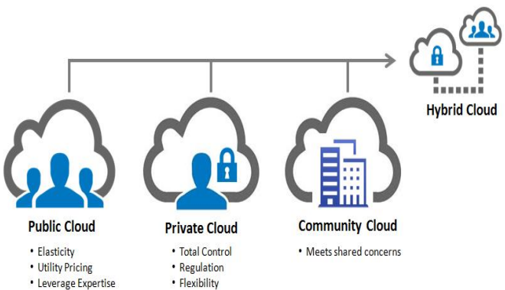
Cloud Deployment Models
Source: swayam

Slide 70
The Key Aspects of Cloud Security
Management
Cloud security
Technology
Operation

Slide 71
Key Aspects of Cloud Security
Management
Alteration of security policies
Cloud security strategy
Cloud security governance
Cloud security processes
Security roles & responsibilities
Cloud security guidelines
Cloud security assessment
Service integration
IT & procurement security requirements
Cloud security management

Slide 72
Key Aspects of Cloud Security
Operation
Awareness and training programs on cloud security
Incident management
Configuration management
Contingency planning
Maintenance
Media protection
Environmental protection
System integrity
Information integrity
Personnel security

Slide 73
Key Aspects of Cloud Security
Technology
Access control Technology and software configuration
System Protection Technology
Authentication Technology
Cloud security audits
Identity and key management
Physical security protection
Backup recovery and archive
Core infrastructure

Slide 74
Risks in Cloud Security
Loss or theft of intellectual property
Compliance of violations and regulatory actions
Loss of control over under user actions
Malware infections that unleash a targeted attack
Contractual breaches with customer or business partners
Diminished customer trust
Data breach requiring disclosure and notification to victims
Increased customer churn
Revenue losses
Cloud Security
Risks
Source: swayam

Slide 75
Tools used in Cloud security
OpenStack is an open source software used for creating private and public clouds
Users can create virtual machines and other instances that do different things in the cloud environment
It allows users to quickly create new VM or instance upon which other cloud components can run providing infrastructure
This puts OpenStack in the Cloud Infrastructure as a Service category

Slide 76
Outsourcing (CO5)
Software Outsourcing is the process of selecting a 3rd party service provider of software development services that will manage all the tasks involved in a development project.
Companies can easily reduce costs with the help of outsourcing software development services.
It’s very difficult for IT firms to stay updated in an environment where new software is rising on a daily basis.

Slide 77
Why Outsource?
Speed up and scale a development team.
Streamlining or increasing efficiency for time-consuming functions
Maximizing use of external resources
Sharing risks with a partner company
Reducing and controlling operating costs
Pros of Software Outsourcing
Flexibility
Increase skills and scale a development team
Enhanced Business Productivity and Cut on Costs
Focusing On a Project and Core Business Value
Risk sharing
Better efficiency
Overwhelming results
Time-saving

Slide 78
Outsourcing Risks
Outsourcing Risks
Unrealistic expectations
Indistinct leadership
Confidentiality of information
Quality of Software
Inadequate technical skills

Slide 79
Supply Chain Management(SCM)(CO5)
Cyber security in the supply chain cannot be viewed as an IT problem only.
Cyber supply chain risks touch sourcing, vendor management, supply chain continuity and quality, transportation security and many other functions across the enterprise and require a coordinated effort to address.
Develop your defences based on the principle that your systems will be breached
Cyber security is never just a technology problem, it’s a people, processes and knowledge problem
Security is Security.

Slide 80
SCM Risks
Third party service providers or vendors – from janitorial services to software engineering -- with physical or virtual access to information systems, software code, or IP.
Poor information security practices by lower-tier suppliers.
Compromised software or hardware purchased from suppliers.
Software security vulnerabilities in supply chain management or supplier systems.
Counterfeit hardware or hardware with embedded malware.
Third party data storage or data aggregators.

Slide 81
SCM Best Practices
Security requirements are included in every RFP and contract.
Once a vendor is accepted in the formal supply chain, a security team works with them on-site to address any vulnerabilities and security gaps.
“One strike and you’re out” policies with respect to vendor products that are either counterfeit or do not match specification.
Component purchases are tightly controlled; component purchases from approved vendors are prequalified. Parts purchased from other vendors are unpacked, inspected, and x-rayed before being accepted.

Slide 82
SCM Best Practices
Secure Software Lifecycle Development Programs and training for all engineers in the life cycle are established.
Source code is obtained for all purchased software.
Software and hardware have a security handshake. Secure booting processes look for authentication codes and the system will not boot if codes are not recognized.
Automation of manufacturing and testing regimes reduces the risk of human intervention.

Slide 83
Daily Quiz
What are the Threats to e-mail security?
What are the Threats to Mobile Device Security?
What are the key aspects to cloud Security?
What is OpenStack ?
What is Spam mail?

Slide 84
Weekly Assignment
What do you mean by policy? why it is developed and reviewed?
Explain is email system andEmail Policy.
Describe WWW policy.
Briefly explain the role of security in Internet and Web services.
Describe corporate policy
Discuss security issues in Supply Chain Management(SCM)
Classify the risk in cloud security.
Describe Common risks in Mobile Devices.
Explain steps in Policy Review Process
What are the common threats to mobile devices

Slide 85
Faculty Video Links, Youtube & NPTEL Video Links and Online Courses Details
https://youtu.be/tZJoMjEsf4E
https://youtu.be/09NW4WeBLrw
https://www.youtube.com/watch?v=L-cC-JjYos0
https://www.youtube.com/watch?v=QxEpued61OI
https://www.youtube.com/watch?v=ahNb6kA0Lms
https://www.youtube.com/watch?v=ZnxnTLPcdDk
https://www.youtube.com/watch?v=Og9lf0StwVA

Slide 86
Faculty Video Links, Youtube & NPTEL Video Links and Online Courses Details
https://www.youtube.com/watch?v=E47ew_IsqaM
https://www.youtube.com/watch?v=gDtlbGK13xM
https://www.youtube.com/watch?v=xFzaoJjzXJQ
https://youtu.be/RQOJgEA5e1k
https://youtu.be/GKqOWCK71K4
https://youtu.be/zDDkNq6kpRE

Slide 87
Glossary Questions
Fill the right options:
Community, Confidentiality of Information, mass email, Define Goal of the Policy
Risk associated with outsourcing _______________
One type of cloud deployment model____
On commandment of email security policy: You will not transmit ____________unsolicited to anyone.
Step one of policy development ________

Slide 88
Recap of Unit
Policy design Task
WWW Policies
Email based Policies
Policy Revaluation Process-Corporate Policies-Sample Security Policies
Publishing and Notification Requirement of the updated and new Policies
Recent trends in security

Slide 89
Daily Quiz
Figure out the vulnerability that targets scripts embedded in a page executed on the client side. a) Web application firewall b) Cross Site Scripting c) Network d) Objects
Label the process of setting up of fake access points in high traffic public locations. a) Unsecured Wi-Fi b) Phishing Attacks c) Network Spoofing d) Spyware
3. Recognize the cheapest form of Authentication. a) Password based Authentication b) Encryption c) Biometric based Authentication d) Smart cards

Slide 90
Daily Quiz
4. Which of the following implies the influence of the attack when security is compromised in a System? a) Exploitability b) Detectability c) Impact d) None of the above
5. What causes the loss of CIA triad in mobile devices? a) Multiple user logs b) Mobile browsing c) Bluetooth attacks d) Coding issues
6. Choose the model used in implementing and managing security in Cloud. a) Information-as-a-Service (IaaS)
b) Security-as-a-Service (SaaS) c) Platform-as-a-Service (PaaS) d) Human-as-a-Services(HuaaS)

Slide 91
Daily Quiz
7. Determine the older form of Social Engineering. a) Pre-texting b) Phishing c) Baiting d) All the above
8. Point out the technology used for purchasing products securely through mobile devices with an embedded chip. a) Bluetooth b) Virtual Private Network
c) Neat Field Chip d) Neat Field Communication
9. Select the common security concerns that affect cloud systems
a) Unauthorized exposure b) Cloud type c) Data leakage d) Service type
10. 11. Establish the primary components of e-mail system. a) Network b) Mail Clients c) Mail Servers d) Protocols

Slide 92
Weekly Assignment
Collect the various web security risks and the strategies to solve them.
Examine and analyze the common threats encountered in email security.
Describe the components of mobile device security.
Demonstrate the key aspects in maintaining cloud security.
What is cloud architecture? How is cloud different from traditional data centers?
How can you deploy cloud computing with different models?

Slide 93
MCQ s
1. Analyze the common places where user interactions take place in WebPages. a) Form/search field b) Code area
c) Blogs d) Empty area
2. Which of the following is the operational domain of CSA? a) Scalability b) Portability and interoperability c) Flexibility d) None of the mentioned

Slide 94
MCQ s
3. Which of the following ensure interoperability between different mail clients and servers? a) Simple Mail Transfer Protocol b) Extended Simple Mail Transfer Protocol c) Extended Simple Mail Transfer Protocol d) Internet Message Protocol

Slide 95
MCQ s
Which of the following policy helps in avoiding the risk of browsing the Internet accessing sites containing offensive material?
a) WWW policy b) Email Policy
c) Corporate policy d) All
Determine the older form of Social Engineering.
a) Pre-texting b) Phishing
c) Baiting d) All
Which of them is not a major way of stealing email information?
a) Stealing cookies b) Reverse Engineering
c) Password Phishing c) Social Engineering

Slide 96
MCQ s
Which of them is not a proper method for email security?
a) Use Strong password
b) Use email Encryption
c) Spam filters and malware scanners
d) Click on unknown links to explore
Unsolicited Bulk E-mails (UBI) are called __________
a) SMS
b) MMS
c) Spam emails
d) Malicious emails
Lack of access control policy is a _____________
a) Bug
b) Threat
c) Vulnerability
d) Attack

Slide 97
MCQ s
Data leakage threats do not usually occur from which of the following?
a) Web and email
b) Mobile data storage
c) USB drives and laptops
d) Television
Spywares can be used to steal _______________ from the attacker’s browser.
a) browsing history b) company details
c) plug-ins used d) browser details
Which of the following is not a spot from where attackers seek information?
a) Domain name b) IP address
c) System enumeration d) Document files

Slide 98
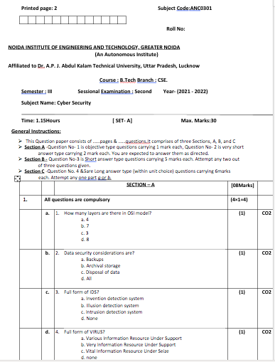
Past Sessional Papers

Slide 99
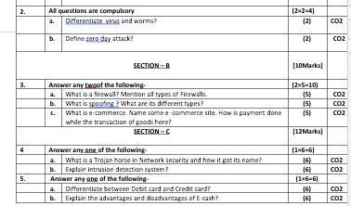
Past Sessional Papers

Slide 100
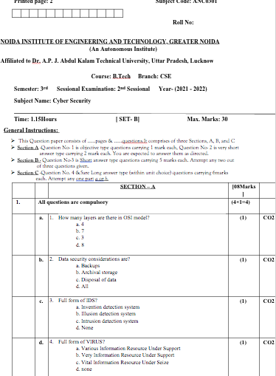
Past Sessional Papers

Slide 101
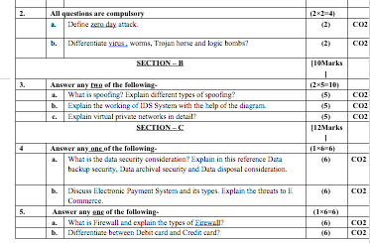
Past Sessional Papers

Slide 102
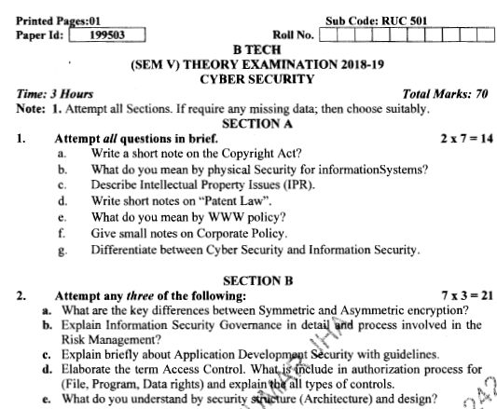
Old Question Papers

Slide 103
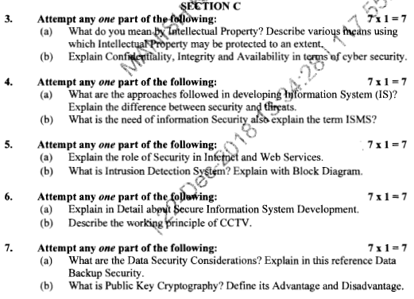
Old Question Papers

Slide 104
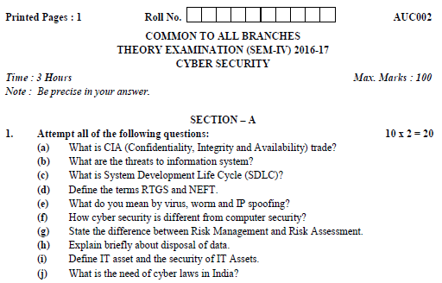
Old Question Papers

Slide 105
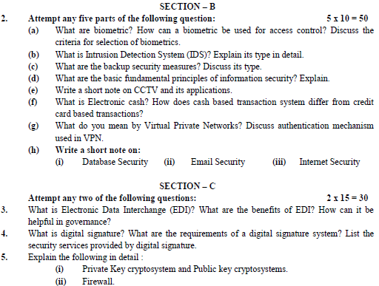
Old Question Papers

Slide 106
Expected Questions for University Exam
Explain the Recent Trends in security in mobile.
Explain the Recent Trends in security in cloud.
Explain the need for Information Security Policies.
What are the components of cyber security?
The most dangerous vulnerabilities in stored mobile data?
How to protect email messages?
What are the risks associated with public Wi-Fi?
What is a security auditing?

Slide 107
Summary
Policy design Task
WWW Policies
Email based Policies
Policy Revaluation Process-Corporate Policies-Sample Security Policies
Publishing and Notification Requirement of the updated and new Policies
Recent trends in security

Slide 108
References
Dr. Surya Prakash Tripathi, Ritendra Goyal, Praveen kumar Shukla ,”Introduction to Information Security and Cyber Law” Willey Dreamtech Press.(prefer)
http://caaa.in/Image/cyber%20laws%20overview.pdf
https://taxguru.in/wp-content/uploads/2012/10/cyber-laws-overview.pdf
https://www.tutorialspoint.com/information_security_cyber_law/information_security_cyber_law_tutorial.pdf
http://lawcommissionofindia.nic.in/1-50/Report42.pdf
http://www.caaa.in/Image/34_Hb_on_IPR.pdf
http://www.esi.mil/download.aspx?id=6073
https://onlinecourses.swayam2.ac.in/cec20_cs09/unit?unit=244&lesson=253

Slide 109
Thank You

